Slide 1
Storage and File Organization
Notes:
1

Slide 2
Internal Schema Design

Slide 3
Data on External Storage
Disks: Can retrieve random page at fixed cost
But reading several consecutive pages is much cheaper than reading them in random order
Tapes: Can only read pages in sequence
Cheaper than disks; used for archival storage
File organization: Method of arranging a file of records on external storage.
Record id (rid) is sufficient to physically locate record
Indexes are data structures that allow us to find the record ids of records with given values in index search key fields
Architecture: Buffer manager stages pages from external storage to main memory buffer pool. File and index layers make calls to the buffer manager.

Slide 4
Alternative File Organizations
Many alternatives exist, each ideal for some situations, and not so good in others:
Heap (random order) files: Suitable when typical access is a file scan retrieving all records.
Sorted Files: Best if records must be retrieved in some order, or only a `range’ of records is needed.
Indexes: Data structures to organize records via trees or hashing.
Like sorted files, they speed up searches for a subset of records, based on values in certain (“search key”) fields
Updates are much faster than in sorted files.
Notes:
2

Slide 5
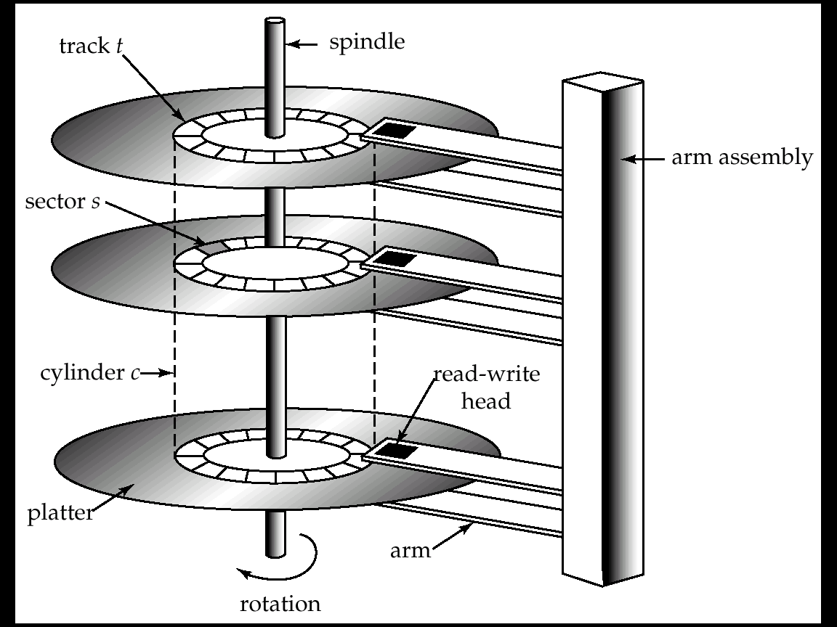
Magnetic Hard Disk Mechanism
NOTE: Diagram is schematic, and simplifies the structure of actual disk drives

Slide 6
Magnetic Disks
Read-write head
Positioned very close to the platter surface (almost touching it)
Reads or writes magnetically encoded information.
A disk pack contains several magnetic disks connected to a rotating spindle.
Disks are divided into concentric circular tracks on each disk surface.
Surface of platter divided into circular tracks
Over 16,000 tracks per platter on typical hard disks
Track capacities vary typically from 4 to 50 Kbytes.
Each track is divided into sectors.
A sector is the smallest unit of data that can be read or written.
Sector size typically 512 bytes
Typical sectors per track: 200 (on inner tracks) to 400 (on outer tracks)
To read/write a sector
disk arm swings to position head on right track
platter spins continually; data is read/written as sector passes under head
Head-disk assemblies
multiple disk platters on a single spindle (typically 2 to 4)
one head per platter, mounted on a common arm.
Cylinder i consists of i^{th} track of all the platters

Slide 7
Disk Storage Devices (contd.)
A track is divided into smaller blocks or sectors
because it usually contains a large amount of information
The division of a track into sectors is hard-coded on the disk surface and cannot be changed.
One type of sector organization calls a portion of a track that subtends a fixed angle at the center as a sector.
A track is divided into blocks.
The block size B is fixed for each system.
Typical block sizes range from B=512 bytes to B=4096 bytes.
Whole blocks are transferred between disk and main memory for processing.

Slide 8
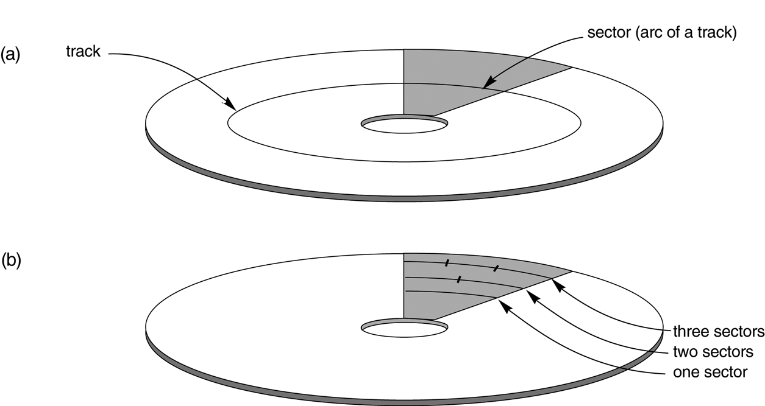
Disk Storage Devices (cont.)

Slide 9
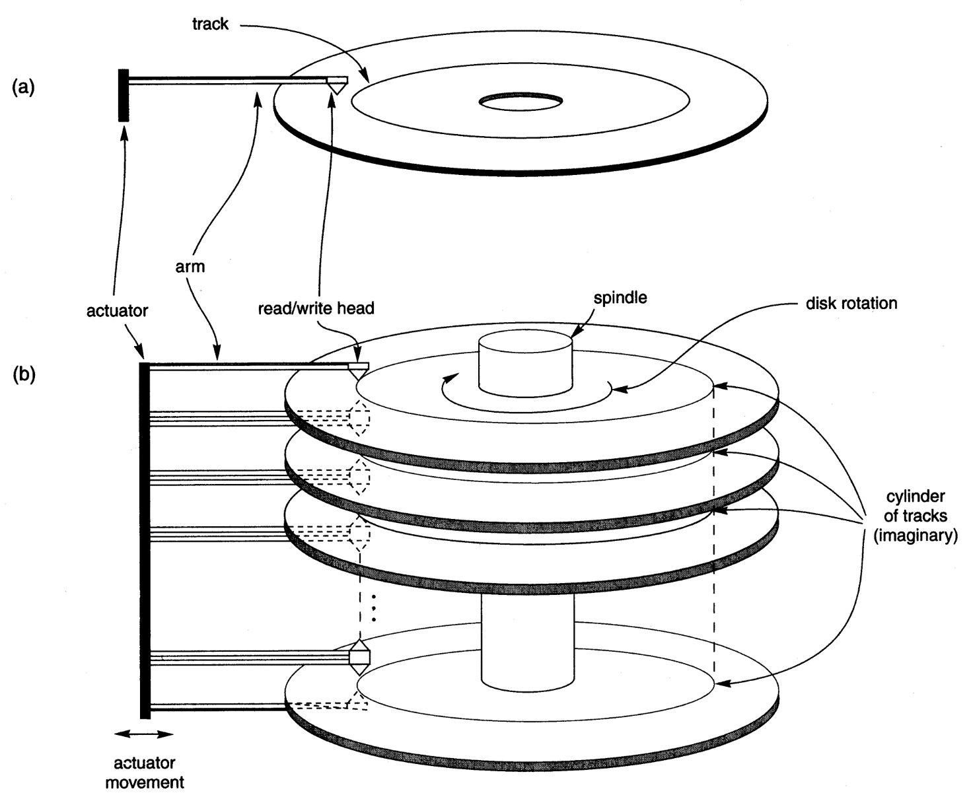
Disk Storage Devices (cont.)

Slide 10
Disk Storage Devices (contd.)
A read-write head moves to the track that contains the block to be transferred.
Disk rotation moves the block under the read-write head for reading or writing.
A physical disk block (hardware) address consists of:
a cylinder number (imaginary collection of tracks of same radius from all recorded surfaces)
the track number or surface number (within the cylinder)
and block number (within track).
Reading or writing a disk block is time consuming because of the seek time s and rotational delay (latency) rd.
Double buffering can be used to speed up the transfer of contiguous disk blocks.

Slide 11
Magnetic Disks (Cont.)
Earlier generation disks were susceptible to head-crashes
Surface of earlier generation disks had metal-oxide coatings which would disintegrate on head crash and damage all data on disk
Current generation disks are less susceptible to such disastrous failures, although individual sectors may get corrupted
Disk controller – interfaces between the computer system and the disk drive hardware.
accepts high-level commands to read or write a sector
initiates actions such as moving the disk arm to the right track and actually reading or writing the data
Computes and attaches checksums to each sector to verify that data is read back correctly
If data is corrupted, with very high probability stored checksum won’t match recomputed checksum
Ensures successful writing by reading back sector after writing it
Performs remapping of bad sectors

Slide 12
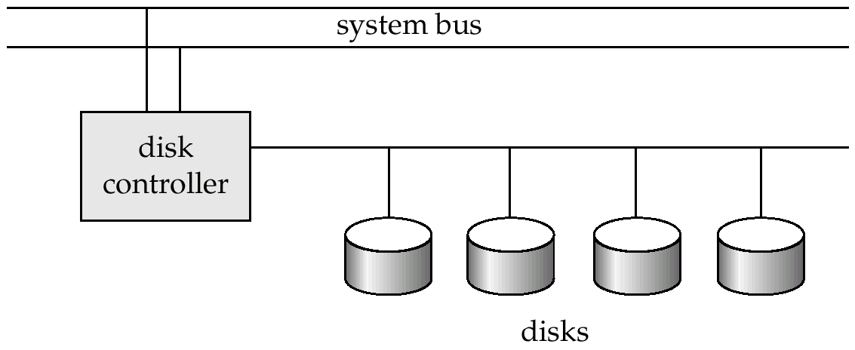
Disk Subsystem
Multiple disks connected to a computer system through a controller
Controllers functionality (checksum, bad sector remapping) often carried out by individual disks; reduces load on controller
Disk interface standards families
ATA (AT adaptor) range of standards
SCSI (Small Computer System Interconnect) range of standards
Several variants of each standard (different speeds and capabilities)

Slide 13
Performance Measures of Disks
Access time – the time it takes from when a read or write request is issued to when data transfer begins. Consists of:
Seek time – time it takes to reposition the arm over the correct track.
Average seek time is 1/2 the worst case seek time.
Would be 1/3 if all tracks had the same number of sectors, and we ignore the time to start and stop arm movement
4 to 10 milliseconds on typical disks
Rotational latency – time it takes for the sector to be accessed to appear under the head.
Average latency is 1/2 of the worst case latency.
4 to 11 milliseconds on typical disks (5400 to 15000 r.p.m.)
Data-transfer rate – the rate at which data can be retrieved from or stored to the disk.
4 to 8 MB per second is typical
Multiple disks may share a controller, so rate that controller can handle is also important
E.g. ATA-5: 66 MB/second, SCSI-3: 40 MB/s
Fiber Channel: 256 MB/s

Slide 14
Performance Measures (Cont.)
Mean time to failure (MTTF) – the average time the disk is expected to run continuously without any failure.
Typically 3 to 5 years
Probability of failure of new disks is quite low, corresponding to a “theoretical MTTF” of 30,000 to 1,200,000 hours for a new disk
E.g., an MTTF of 1,200,000 hours for a new disk means that given 1000 relatively new disks, on an average one will fail every 1200 hours
MTTF decreases as disk ages

Slide 15
Database Tables on Hard Disk
Database tables are made up of one or more tuples (rows)
Each tuple has one or more attributes
One or more tuples from a table are written into a block/page on the hard disk
Larger tuples may need more than one block/page!
Tuples on the disk are known as records
Records are separated by record delimiter
Attributes on the hard disk are known as fields
Fields are separated by field delimiter

Slide 16
File Organization
The physical arrangement of data in a file into records and blocks/pages on the disk
File organization determines the set of access methods for
Storing and retrieving records from a file
Therefore, ‘file organization’ synonymous with ‘access method’
We study three types of file organization
Unordered or Heap files
Ordered or sequential files
Hash files
We examine each of them in terms of the operations we perform on the database
Insert a new record
Search for a record (or update a record)
Delete a record

Slide 17
Unordered Or Heap File
Records are stored in the same order in which they are created
Insert operation
Fast – because the incoming record is written at the end of the last page of the file
Search (or update) operation
Slow – because linear search is performed on pages
Delete Operation
Slow – because the record to be deleted is first searched for
Deleting the record creates a hole in the page
Periodic file compacting work required to reclaim the wasted space

Slide 18
Ordered or Sequential File
Records are sorted on the values of one or more fields
Ordering field – the field on which the records are sorted
Ordering key – the key of the file when it is used for record sorting
Search (or update) Operation
Fast – because binary search is performed on sorted records
Update the ordering field?
Delete Operation
Fast – because searching the record is fast
Periodic file compacting work is, of course, required
Insert Operation
Poor – because if we insert the new record in the correct position we need to shift all the subsequent records in the file
Alternatively an ‘overflow file’ is created which contains all the new records as a heap
Periodically overflow file is merged with the main file
If overflow file is created search and delete operations for records in the overflow file have to be linear!

Slide 19
Hash File
Is an array of buckets
Given a record, r a hash function, h(r) computes the index of the bucket in which record r belongs
h uses one or more fields in the record called hash fields
Hash key - the key of the file when it is used by the hash function
Example hash function
Assume that the staff last name is used as the hash field
Assume also that the hash file size is 26 buckets - each bucket corresponding to each of the letters from the alphabet
Then a hash function can be defined which computes the bucket address (index) based on the first letter in the last name.

Slide 20
Hash File (2)
Insert Operation
Fast – because the hash function computes the index of the bucket to which the record belongs
If that bucket is full you go to the next free one
Search Operation
Fast – because the hash function computes the index of the bucket
Performance may degrade if the record is not found in the bucket suggested by hash function
Delete Operation
Fast – once again for the same reason of hashing function being able to locate the record quick

Slide 21
Blocking
Blocking:
Refers to storing a number of records in one block on the disk.
Blocking factor (bfr) refers to the number of records per block.
There may be empty space in a block if an integral number of records do not fit in one block.
Spanned Records:
Refers to records that exceed the size of one or more blocks and hence span a number of blocks.

Slide 22
Files of Records
A file is a sequence of records, where each record is a collection of data values (or data items).
A file descriptor (or file header) includes information that describes the file, such as the field names and their data types, and the addresses of the file blocks on disk.
Records are stored on disk blocks.
The blocking factor bfr for a file is the (average) number of file records stored in a disk block.
A file can have fixed-length records or variable-length records.

Slide 23
Files of Records (contd.)
File records can be unspanned or spanned
Unspanned: no record can span two blocks
Spanned: a record can be stored in more than one block
The physical disk blocks that are allocated to hold the records of a file can be contiguous, linked, or indexed.
In a file of fixed-length records, all records have the same format. Usually, unspanned blocking is used with such files.
Files of variable-length records require additional information to be stored in each record, such as separator characters and field types.
Usually spanned blocking is used with such files.

Slide 24
Operation on Files
Typical file operations include:
OPEN: Readies the file for access, and associates a pointer that will refer to a current file record at each point in time.
FIND: Searches for the first file record that satisfies a certain condition, and makes it the current file record.
FINDNEXT: Searches for the next file record (from the current record) that satisfies a certain condition, and makes it the current file record.
READ: Reads the current file record into a program variable.
INSERT: Inserts a new record into the file & makes it the current file record.
DELETE: Removes the current file record from the file, usually by marking the record to indicate that it is no longer valid.
MODIFY: Changes the values of some fields of the current file record.
CLOSE: Terminates access to the file.
REORGANIZE: Reorganizes the file records.
For example, the records marked deleted are physically removed from the file or a new organization of the file records is created.
READ_ORDERED: Read the file blocks in order of a specific field of the file.

Slide 25

Attendance (14.03.2020)

Slide 26
Data representation

Slide 27
Issues
How do we represent
Datatypes as fields
Fixed/variable tuples
Records into blocks
Relation as collection of blocks (file)
How do we handle Database modifications when record size changes

Slide 28
File Organization
The database is stored as a collection of files. Each file is a sequence of records. A record is a sequence of fields.
One approach:
assume record size is fixed
each file has records of one particular type only
different files are used for different relations

Slide 29
Representing DataTypes
Fixed length Character String: CHAR(n)
Using special ‘Pad’ Character
Variable length Character String: VARCHAR(n)
Using n+1 bytes
Two representations:
Length plus content
Null-terminated string
Dates and Times: DATE (10 byte representation)
Can be represented as fixed/variable character string
A sequence of Bits: BIT(n)
Enumerated Type : finite set of values

Slide 30
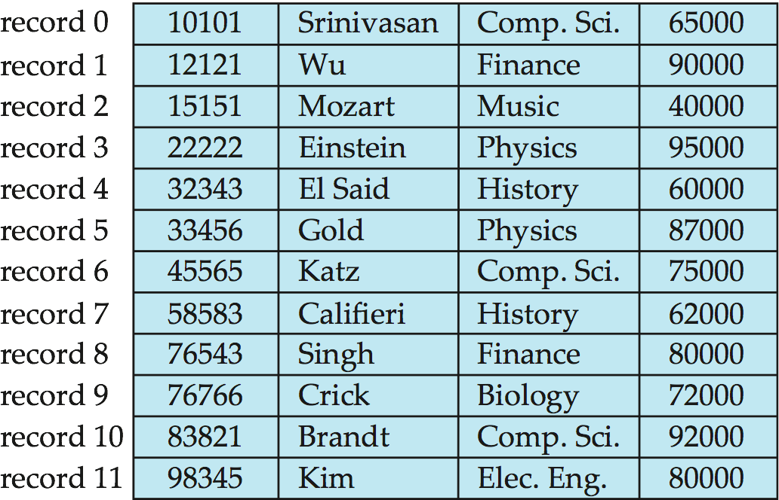
Fixed-Length Records
Simple approach:
Store record i starting from byte n ∗ (i – 1), where n is the size of each record.
Record access is simple but records may cross blocks
Modification: do not allow records to cross block boundaries
Deletion of record i: alternatives:
move records i + 1, . . ., n to i, . . . , n – 1
move record n to i
do not move records, but link all free records on a free list

Slide 31
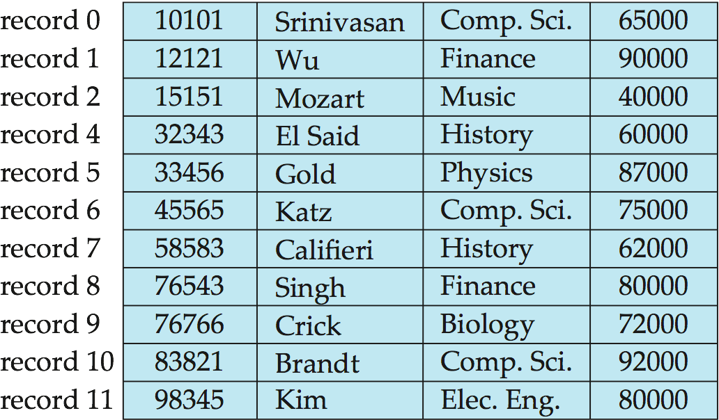
Deleting record 3 and compacting

Slide 32
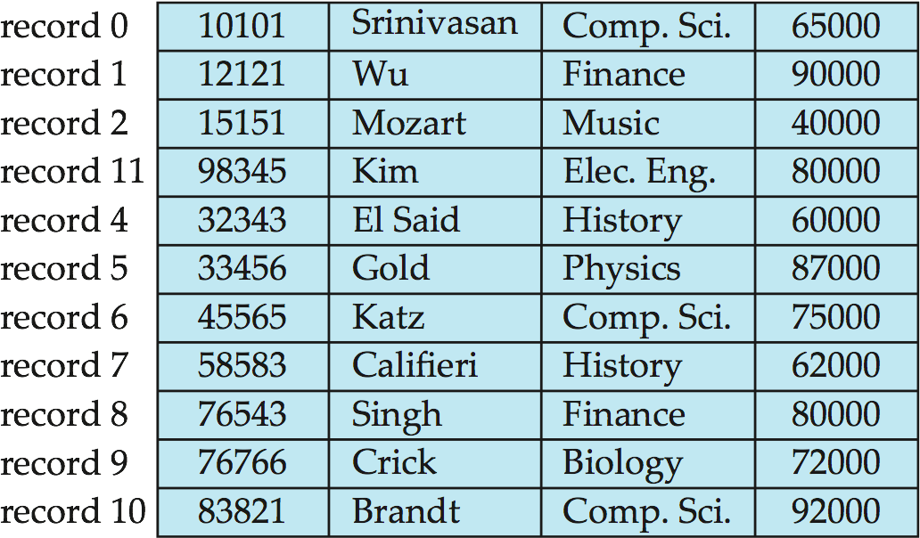
Deleting record 3 and moving last record

Slide 33
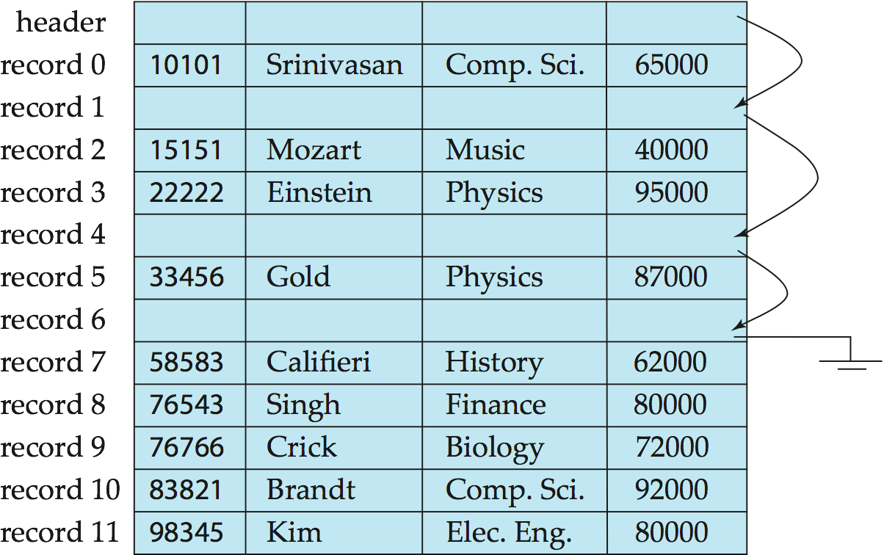
Free Lists
Store the address of the first deleted record in the file header.
Use this first record to store the address of the second deleted record, and so on
Can think of these stored addresses as pointers since they “point” to the location of a record.
More space efficient representation: reuse space for normal attributes of free records to store pointers. (No pointers stored in in-use records.)

Slide 34
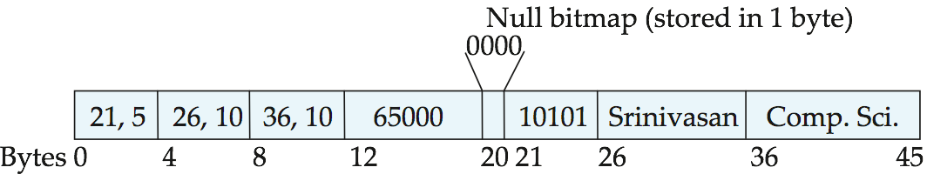
Variable-Length Records
Variable-length records arise in database systems in several ways:
Storage of multiple record types in a file.
Record types that allow variable lengths for one or more fields such as strings (varchar)
Record types that allow repeating fields (used in some older data models).
Attributes are stored in order
Variable length attributes represented by fixed size (offset, length), with actual data stored after all fixed length attributes
Null values represented by null-value bitmap

Slide 35
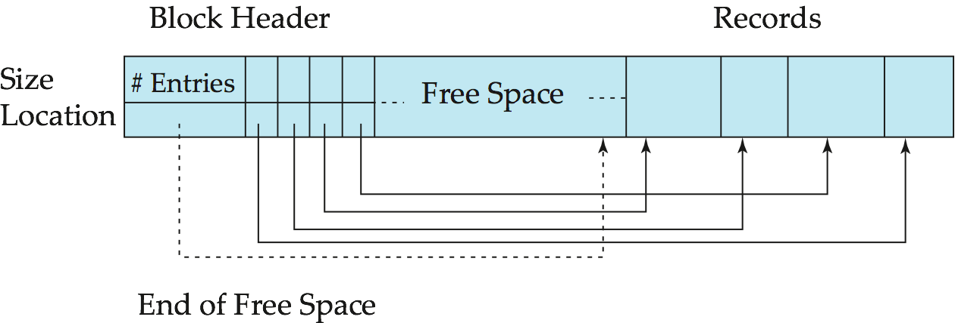
Variable-Length Records: Slotted Page Structure
Slotted page header contains:
number of record entries
end of free space in the block
location and size of each record
Records can be moved around within a page to keep them contiguous with no empty space between them; entry in the header must be updated.
Pointers should not point directly to record — instead they should point to the entry for the record in header.

Slide 36
Unordered Files
Also called a heap or a pile file.
New records are inserted at the end of the file.
A linear search through the file records is necessary to search for a record.
This requires reading and searching half the file blocks on the average, and is hence quite expensive.
Record insertion is quite efficient.
Reading the records in order of a particular field requires sorting the file records.

Slide 37
Ordered Files
Also called a sequential file.
File records are kept sorted by the values of an ordering field.
Insertion is expensive: records must be inserted in the correct order.
It is common to keep a separate unordered overflow (or transaction) file for new records to improve insertion efficiency; this is periodically merged with the main ordered file.
A binary search can be used to search for a record on its ordering field value.
This requires reading and searching log₂ of the file blocks on the average, an improvement over linear search.
Reading the records in order of the ordering field is quite efficient.

Slide 38
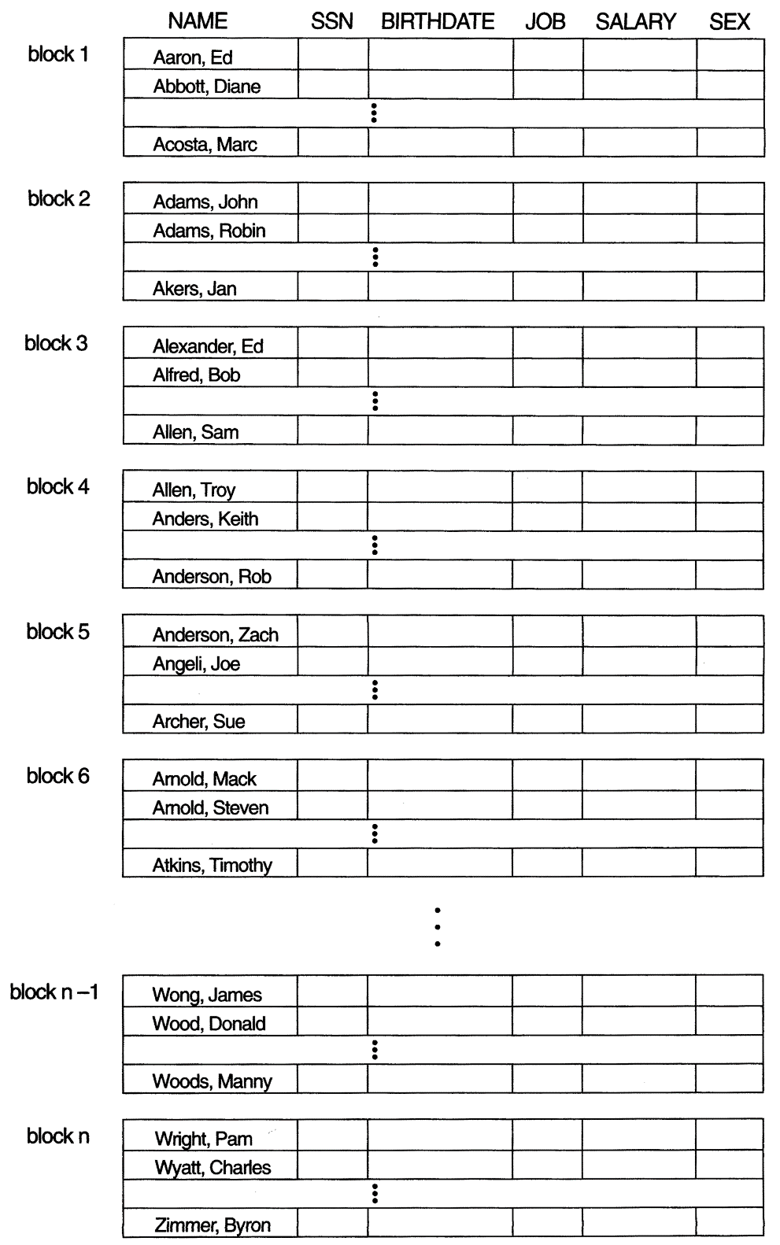
Ordered Files

Slide 39
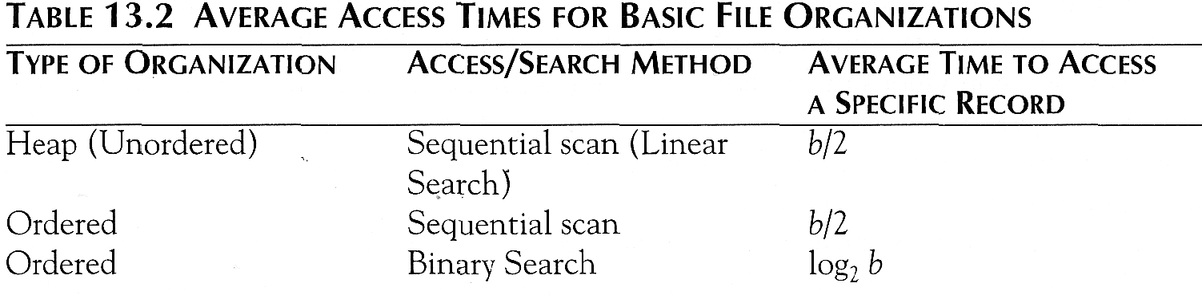
Average Access Times
The following table shows the average access time to access a specific record for a given type of file

Slide 40
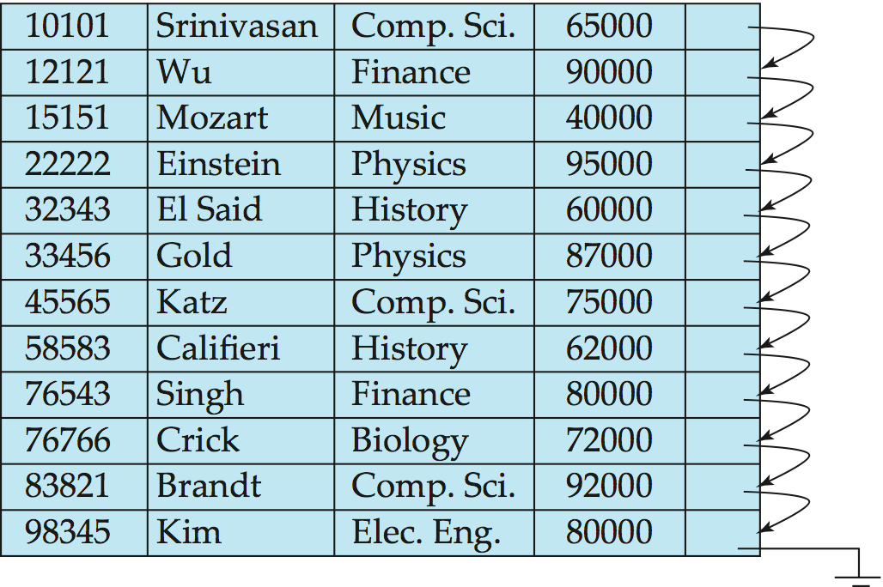
Sequential File Organization
Suitable for applications that require sequential processing of the entire file
The records in the file are ordered by a search-key

Slide 41
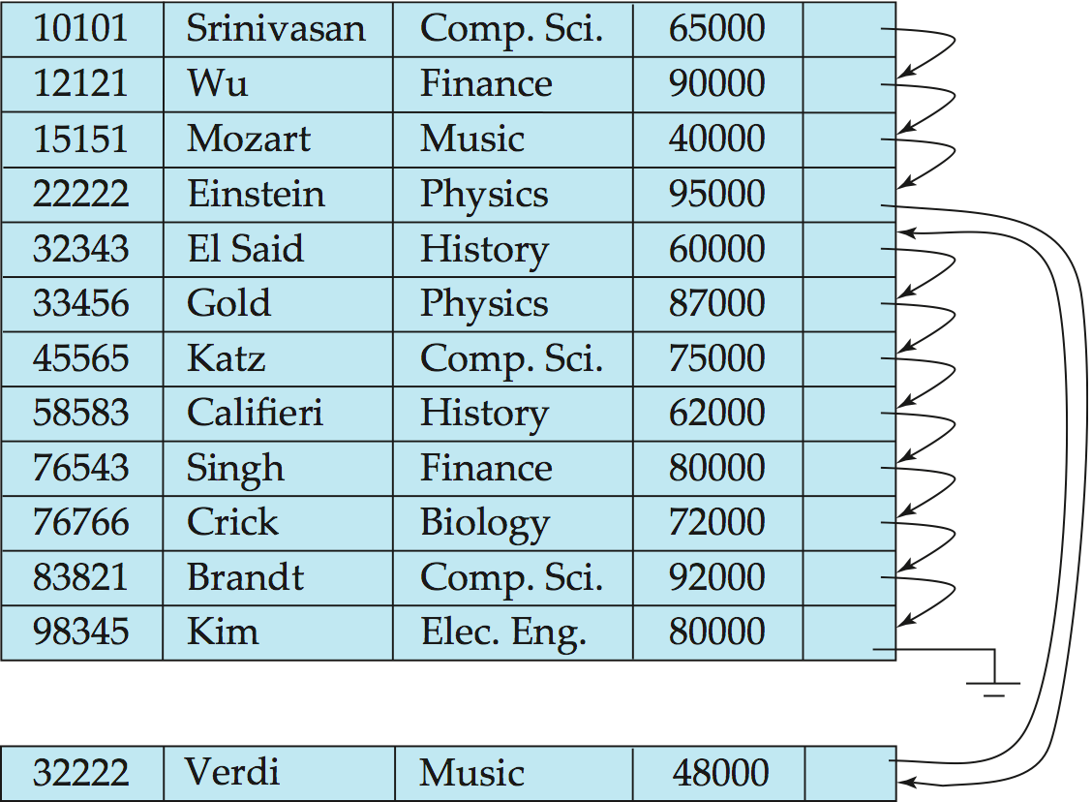
Sequential File Organization (Cont.)
Deletion – use pointer chains
Insertion –locate the position where the record is to be inserted
if there is free space insert there
if no free space, insert the record in an overflow block
In either case, pointer chain must be updated
Need to reorganize the file from time to time to restore sequential order

Slide 42
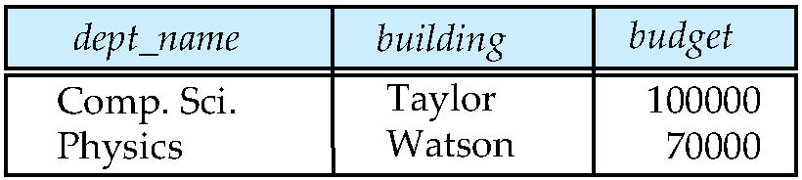
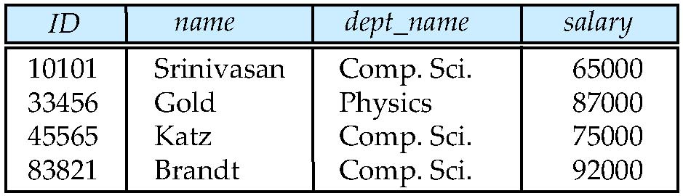
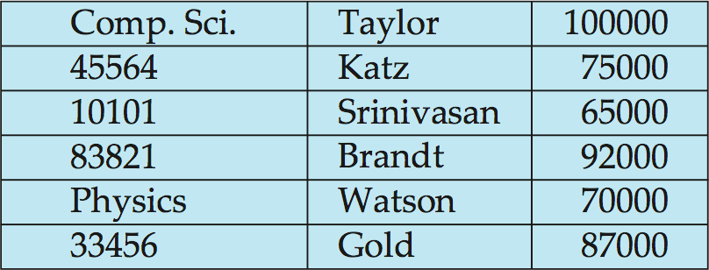
Multitable Clustering File Organization
Store several relations in one file using a multitable clustering file organization
department
instructor
multitable clustering
of department and
instructor

Slide 43
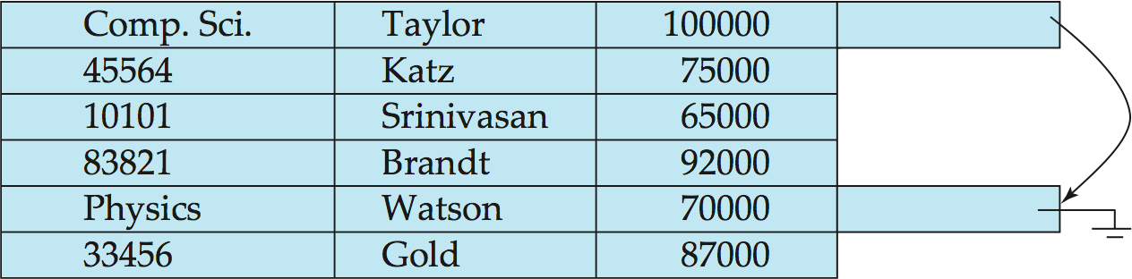
Multitable Clustering File Organization (cont.)
good for queries involving department instructor, and for queries involving one single department and its instructors
bad for queries involving only department
results in variable size records
Can add pointer chains to link records of a particular relation

Slide 44
Data Dictionary Storage
The Data dictionary (also called system catalog) stores metadata; that is, data about data, such as
Information about relations
names of relations
names, types and lengths of attributes of each relation
names and definitions of views
integrity constraints
User and accounting information, including passwords
Statistical and descriptive data
number of tuples in each relation
Physical file organization information
How relation is stored (sequential/hash/…)
Physical location of relation
Information about indices

